Slide 1
Coffee/Tea Cooled Notification SystemTM
Carter Norsen
Notes:
Hi i’m carter
I made a system that notifies you when a coffee or tea is cooled
No i cant think of a better name

Slide 2


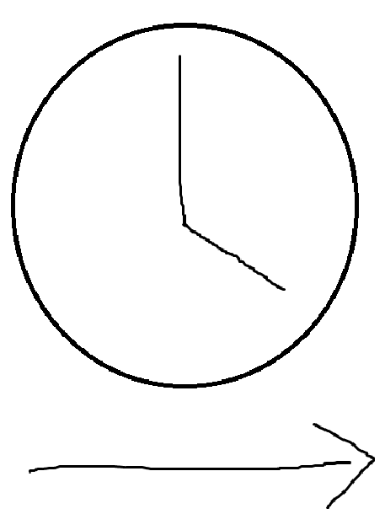
The Problem
Notes:
I make a lot of tea to stay awake when doing HW
I leave the tea alone while it cools, then come back later to get it when it’s done
Often I wait too long and the tea is cold

Slide 3
Objectives
Needs to alert me when the tea is cooled
  Need to figure out what “cooled” means numerically
  Need to detect when the tea is cooled
Signal needs to travel a long distance
  Making a loud annoying sound is too easy
Alert needs to be obvious
  Visual is best
Notes:
I want a way to alert me from the kitchen to my desk when the tea is cooled
Which means i need to figure out what that means exactly so i can measure it
convert that into a signal
Signal needs to need to reach from the kitchen to my desk
but just making a sound play from the source is too easy,
so i want a physical connection
When it reaches me, i need to notice it
I often have earbuds in and have neighbors

Slide 4
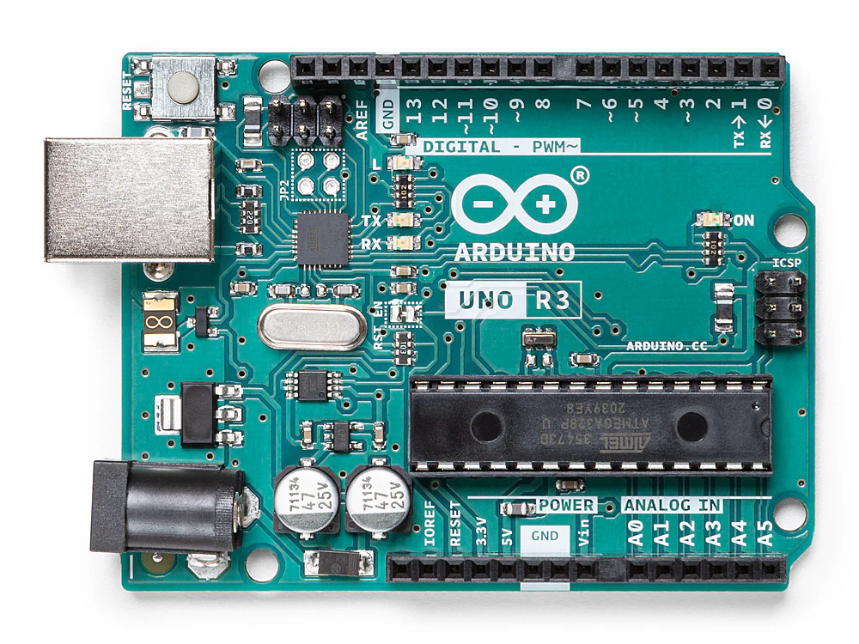
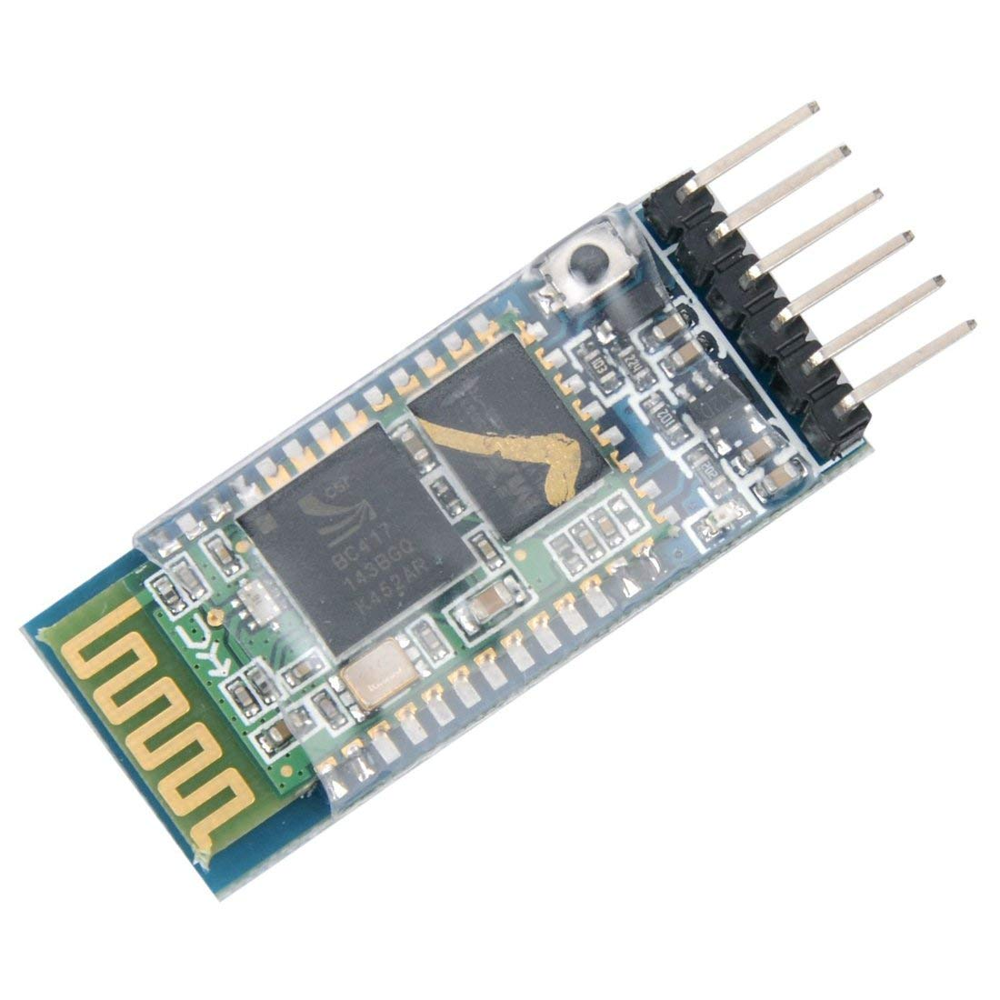
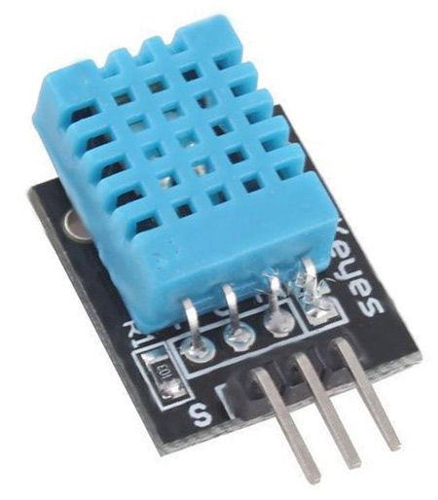


Solution Concept
Two Arduino Unos connected via Bluetooth
  HC-05 Bluetooth module
DHT11 Temperature/Humidity Sensor
Laser display activates at threshold
Notes:
My solution is to use two arduino unos connected with bluetooth using the hc05 bluetooth module (right)
Have dht11 (included in digital design kit we all had to buy) connected to one of them
Use that to detect tea temperature
Alert me using the other arduino using an array of dirt cheap lasers
They can shine onto the wall or something, even display text

Slide 5
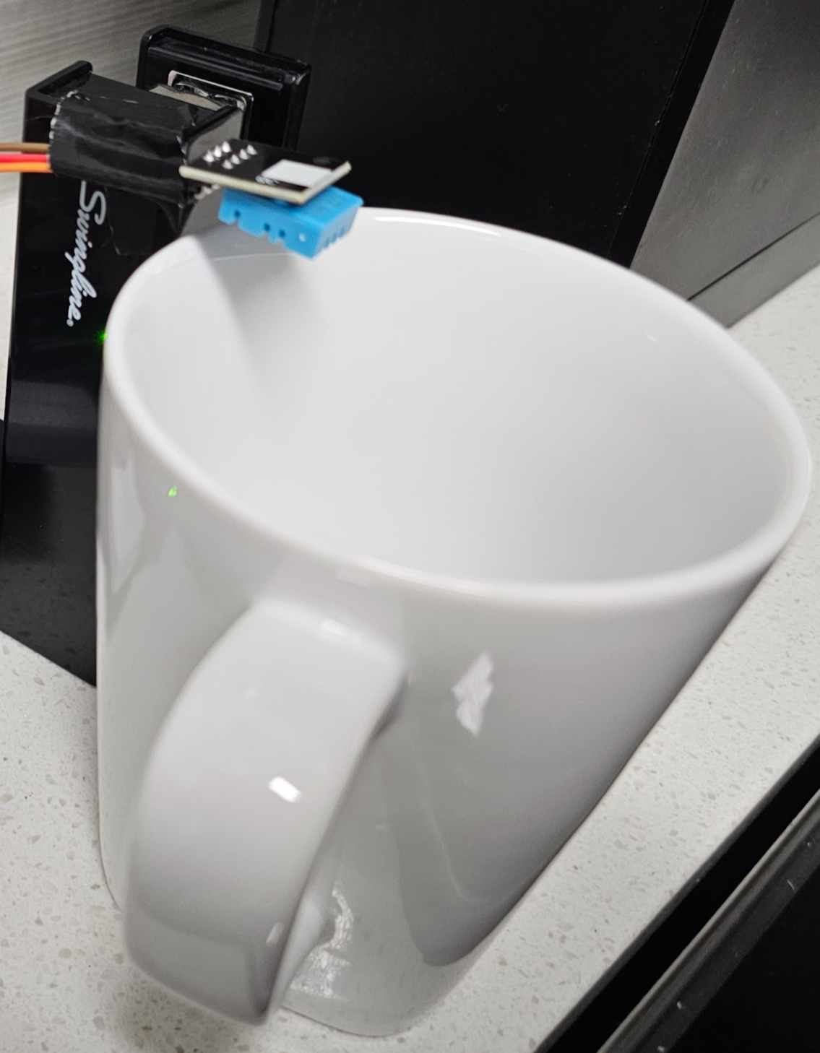
Challenges
Physical construction is not hard (except DHT11 →)
Bluetooth configuration using HC-05
Sending data over Bluetooth
DHT11 readings are very inconsistent
Notes:
A few challenges
Construction did not take too long, only a few wires on some breadboards and duct tape for the rest
The code was the hard part
Hc05 configuration is difficult
Had to learn AT commands and serial printing, was a lot of work
They have different wiring configurations at different stages, miracle they still work
It is surprisingly hard to send a floating point value over bluetooth and serial connection
Have to convert to and from string
Can only send one byte at a time
DHT11 readings swing wildly
Will often dip below cooled for extended periods of time then go back up
Had to implement a moving average
Had to read humidity instead since it was bad at reading temperature

Slide 6
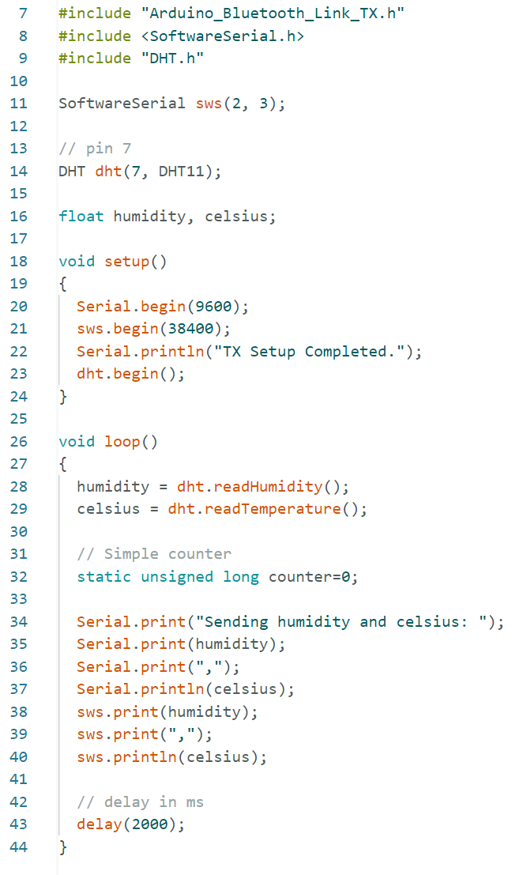
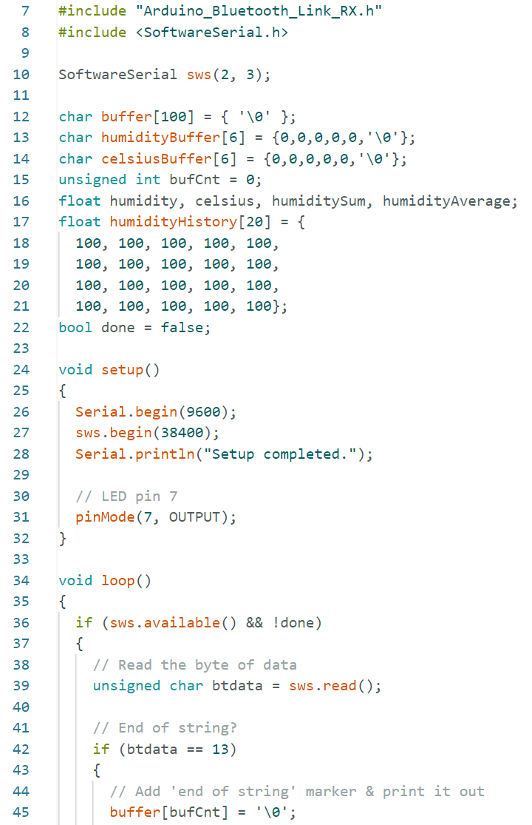
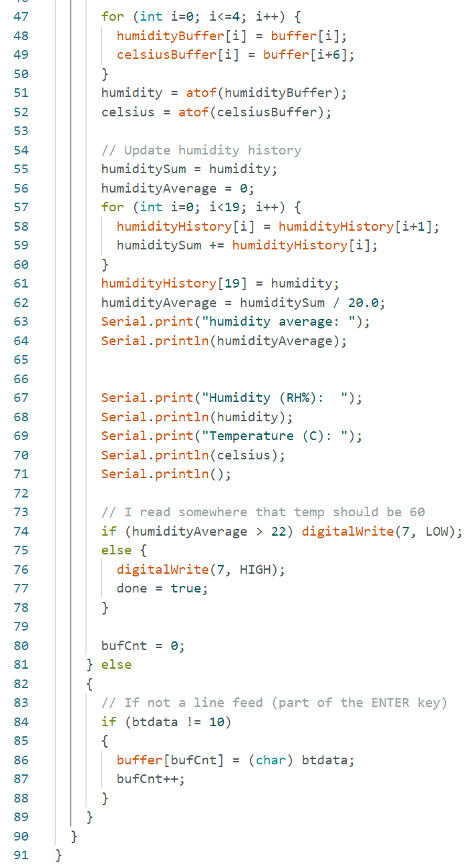
Code
Notes:
Since most of the project is code here it is
No AT commands I have to disassemble the project to be able to access them
Board using DHT11 on left, features added DHT code and serial printing
Receiving board with lasers on the left two, features
buffers, moving average initialization, serial reading,
string to float conversion, updating moving average, ending the loop if average goes below humidity threshold

Slide 7
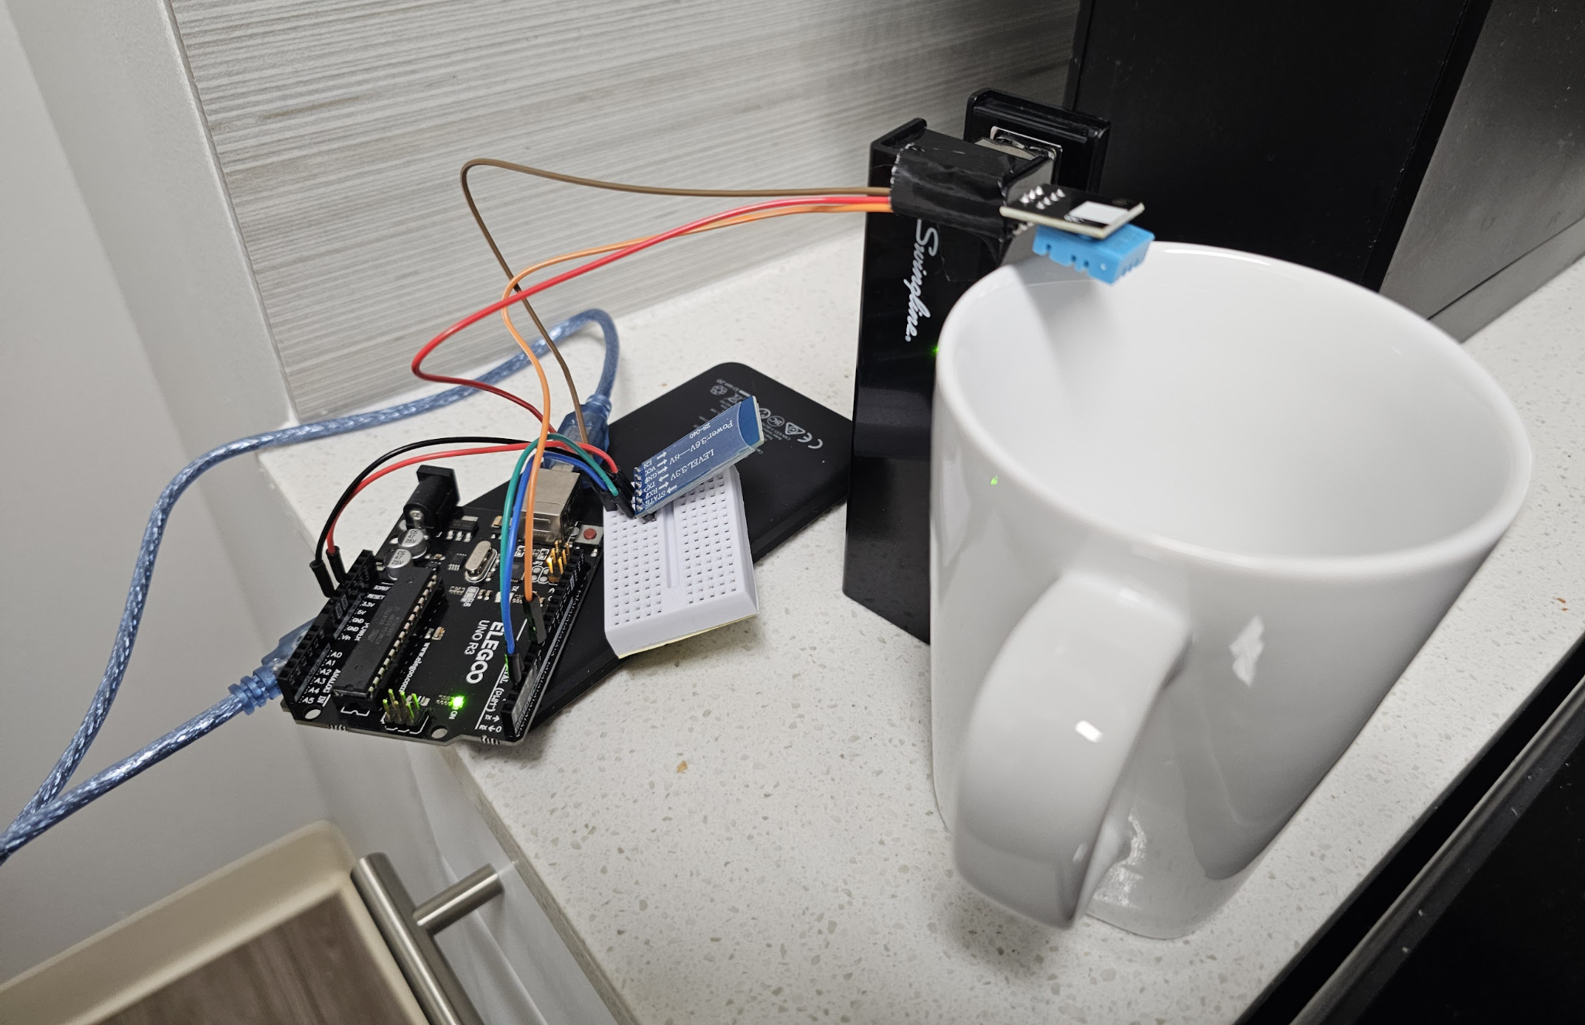
Design (Humidity Reading Side)
Notes:
First half, side that reads and sends humidity data
Dht11 suspended over mug duct taped to a stapler
Arduino and hc05 on left powered by a battery underneath
Kinda basic but it gets the job done

Slide 8
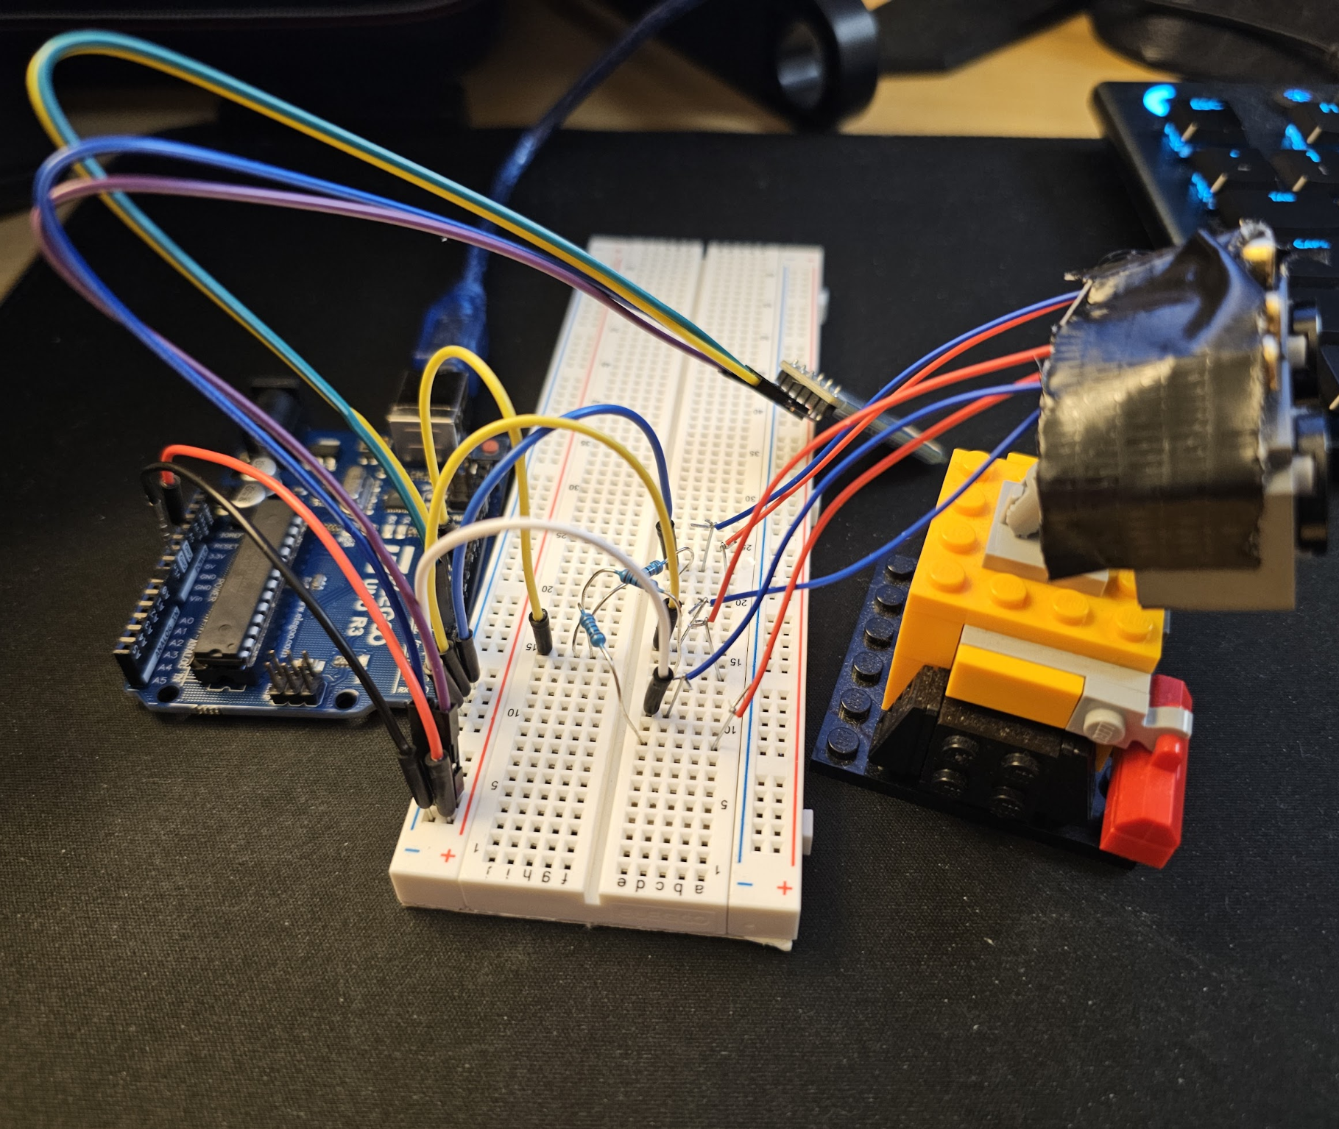
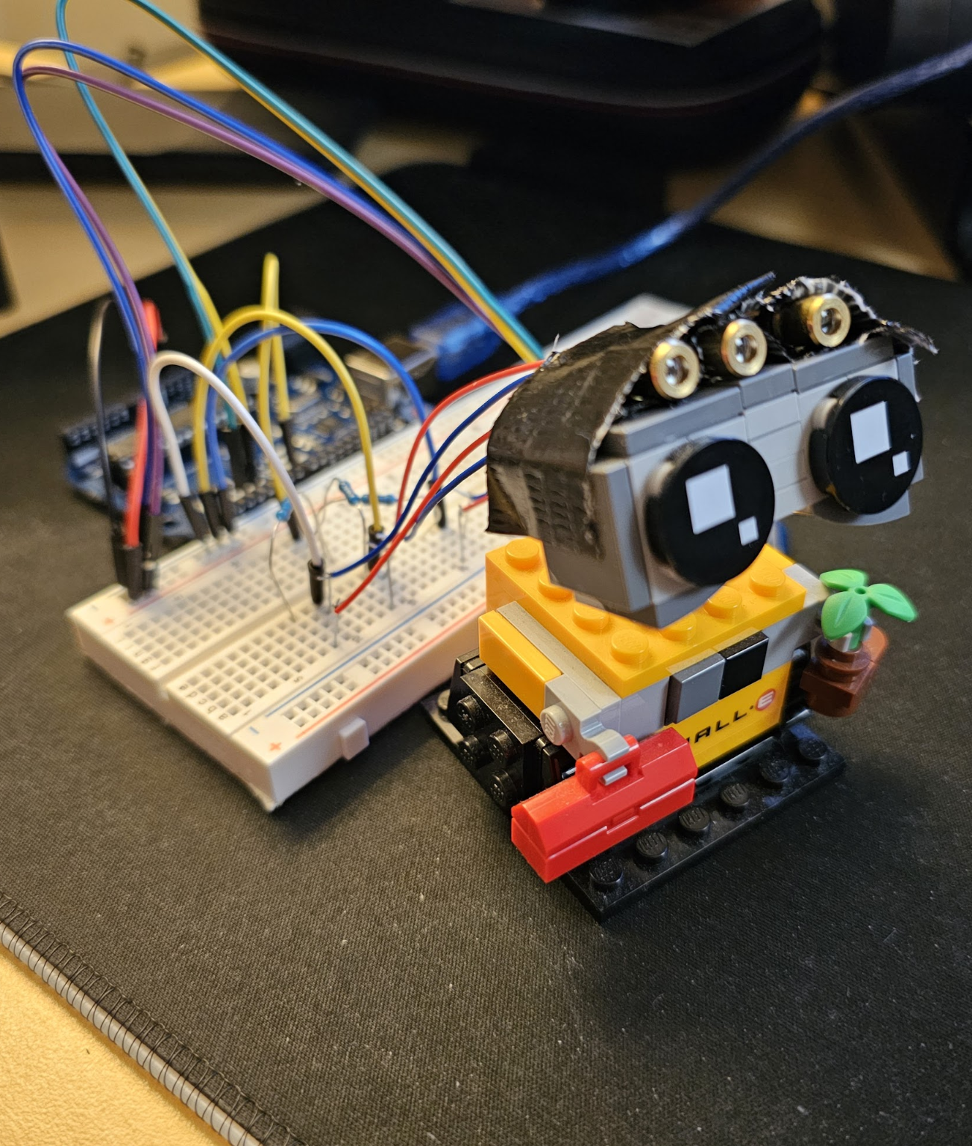
Design (Data Receiving and Alerting Side)
Notes:
Second half, side that receives the humidity data and alerts me with lasers
Also kinda basic but looks a lot worse
Attached lasers to a lego wall e to get the angle right
Only 3 lasers because i ran out of resistors
Also laser wires are too thin for breadboard so I attached them to staples which is hard
At least only one of them has to work
To set up, simply point at your wall not at your eyes and connect to power

Slide 9
Demo Using Ambient Humidity
(Proof of Concept)
Notes:
Show serial monitor
Breath on the humidity sensor

Slide 10
Results
Overall worked well despite DHT11
Does alert me when my tea is cooled
Data transfer worked perfectly
Laser display underwhelming
  Phone app instead?
Please don’t remind me about a timer
Notes:
I’d say it worked pretty well despite how bad the humidity sensor is and how bad its positioning is
It does its job of alerting me when my tea is cooled
Sending data over bluetooth surprisingly worked perfectly
Laser could be way better if i spent more time on it
I could figure out a better wire connection than staples
Could make a custom bracket
I have 20 of them so i could display text or a symbol
A lot of people using hc05 modules use a basic phone app as a controller, doesnt sound that much harder
Thats all i have

